Slide 1
GNU/Linux Filesystem
Computer Engineering Department
Mohit Tiwari

Slide 2

What We Will Learn
Introduction
Filesystem Hierarchy Standard
Directory layout of Linux FS
Help
Mounting

Slide 3
Introduction
Filesystem
How are data stored in storage?
How do users access the data?
Data organization, files and directories
Filesystem types
Disk FS: ext2, ext3, FAT, FAT32 & NTFS
Network FS: Samba & NFS
Flash FS: JFFS2
Special FS: proc FS

Slide 4
Introduction (cont’d)
You should understand Linux FS
Why?
Everything in Linux is file, if it is NOT process
Easy to use
Open file, read/write and close the file
Unlike Windows, Linux FS is standard FS
Everyone should learn standards

Slide 5
Filesystem Hierarchy Standard
Started by Dennis Ritchie, 1993
Defines the main directories and their contents in most Linux-based systems
Current Version: 2.3, 29 Jan 2004.

Slide 6
FHS
There is not any drive C:, D:, …
All directories are under “/”
“/” is the root directory
It is possible
to have multiple partitions
to multiple filesystems

Slide 7
The “/”
The primary hierarchy in FSH
The root of tree of filesystem
All paths start form here
There is only one “/” in filesystem

Slide 8
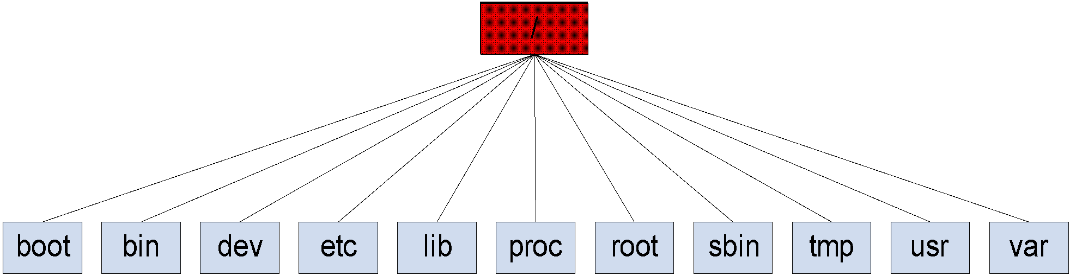
The “/”

Slide 9
boot
Linux kernel
Boot loader configuration
If you lost boot
You cannot boot your OS

Slide 10
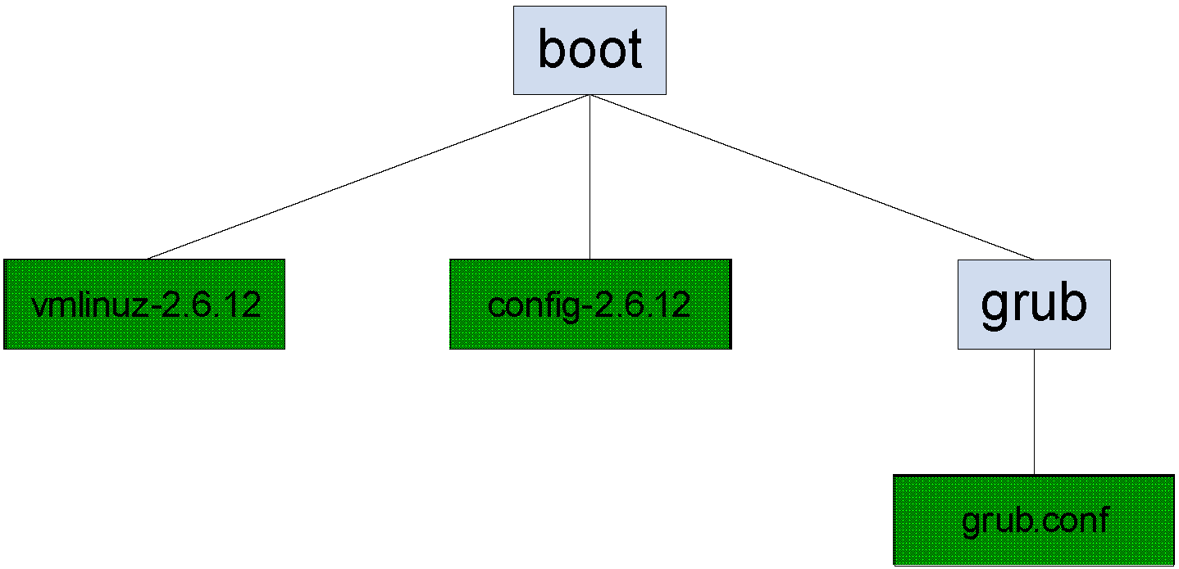
boot

Slide 11
bin
Essential programs
Need for system startup
Basic commands for
Navigating in filesystem
File management

Slide 12
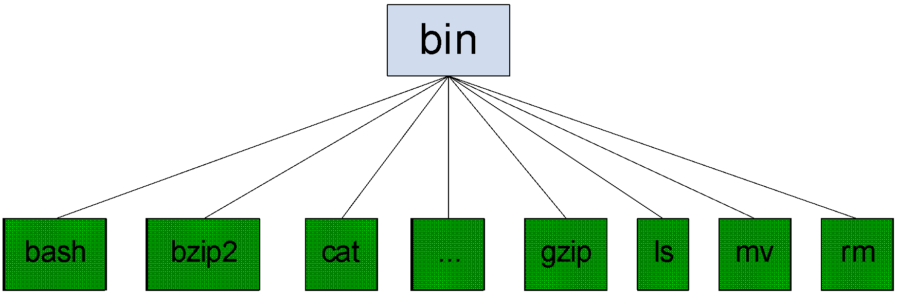
bin

Slide 13
dev
Everything is file
Hardware components (devices) are file
Hard disk
Key board
All device files are here
Direct interaction with device driver
Open the device file
Read & Write

Slide 14
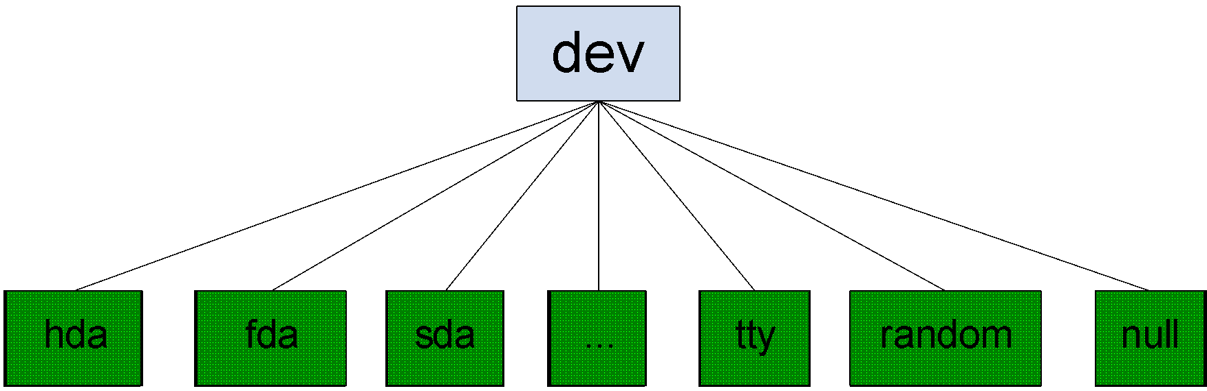
dev

Slide 15
etc
System configuration directory
What is done by the registry in Windows
All configuration file are text files
You can view and edit it manually

Slide 16
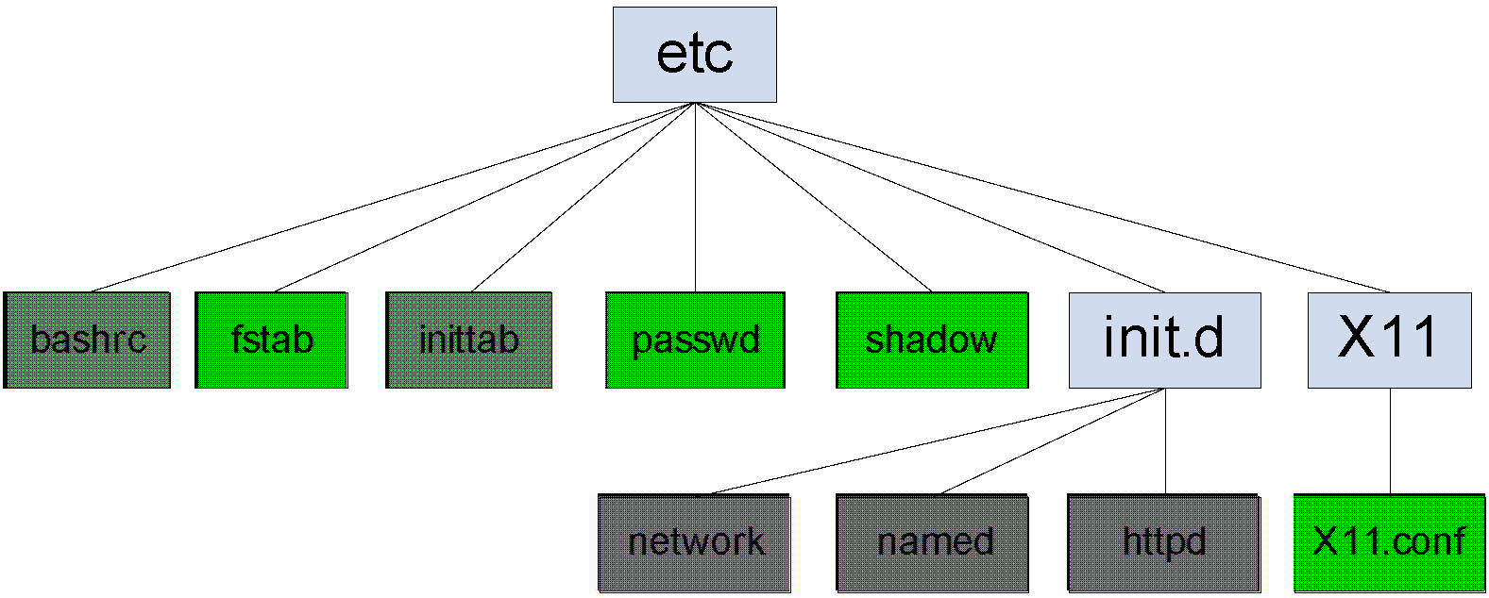
etc

Slide 17
home
Home directory of user
Each user has a directory
/home/mohit
/home/student
All files of user are stored here

Slide 18
lib
Programs need libraries
Dynamically linked libraries
Programmers need libraries
All essential libraries are here
Needed for system startup

Slide 19
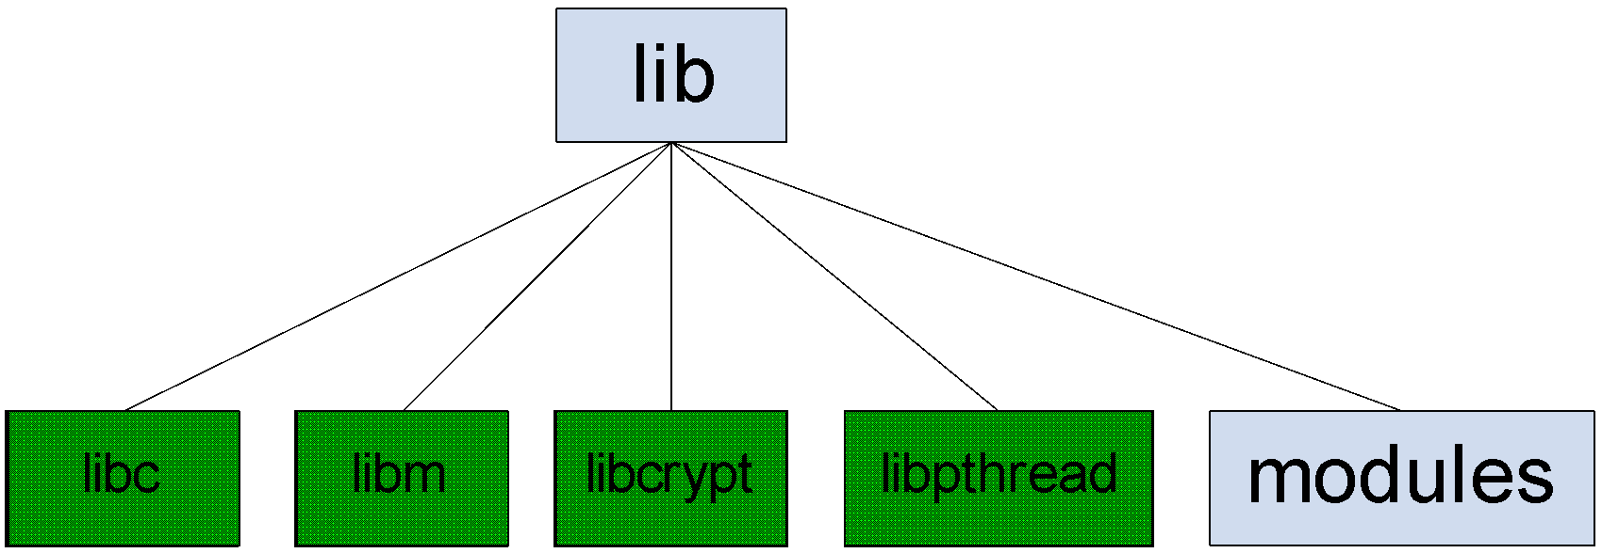
lib

Slide 20
proc
Kernel’s interface
Kernel pseudo-directory
Special directory
It is NOT a directory on hard disk
Kernel Configuration
Kernel State monitoring

Slide 21
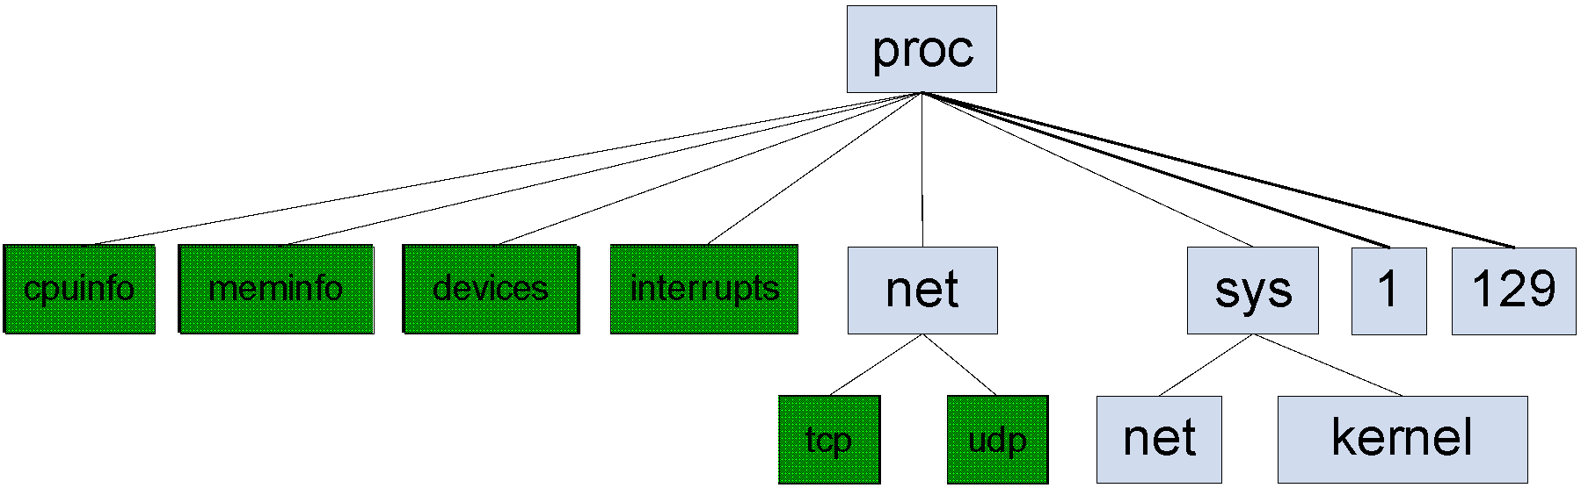
proc

Slide 22
root
Home directory of root
Don’t confuse
/ is the “root of Filesystem”
root is the name of system admin
/root is the admin

Slide 23
sbin
System configuration programs
Format hard disk
Manage hardware
Only “root” can run the programs

Slide 24
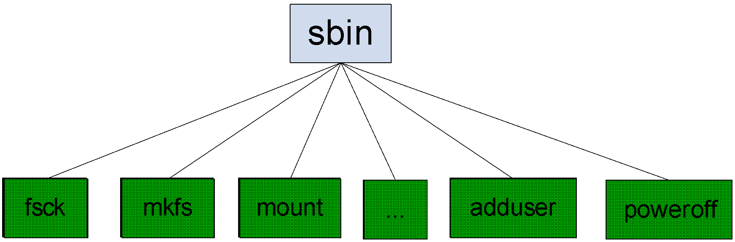
sbin

Slide 25
tmp
Temporary directory
All temp files are created by programs
Your temp files
It is emptied regularly

Slide 26
usr
Secondary hierarchy
Very useful programs
We usually use them
compiler, tools
Are not essential for system startup

Slide 27
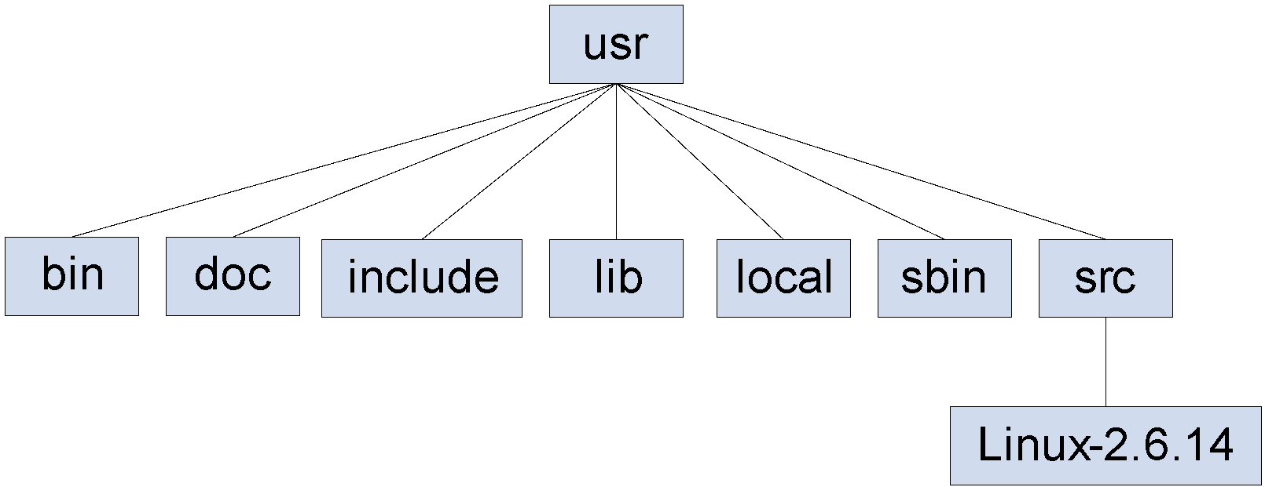
usr

Slide 28
var
The variable directory
All dynamic files
User cannot change the files

Slide 29
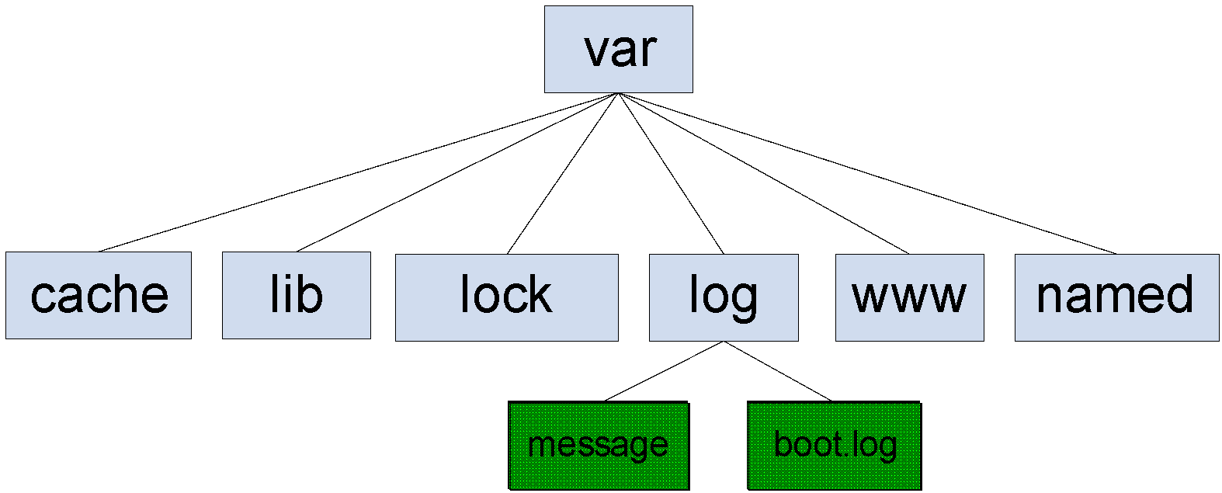
var

Slide 30
Helps
Some documents are in /usr/share/doc
Info pages are not complete help
info <command name>
Man pages
/usr/share/man
man1: user commands, man8: System administration
man <command name>

Slide 31
Permissions
There are 3 basic permissions
Read (r)
Write (w)
Execute (x)
How to find them
ls -l
How to change them
chmod +/- r/w/x <filename>

Slide 32
Mounting
Mount
To add a filesystem to other filesystem
Add you cool-disk FS to you laptop FS
How?
mount <options> <device> <mount point>
mount -t vfat /dev/sdb1 /mnt/flash
Don’t forget the umount
umount <mount point>
umount /mnt/flash

Slide 33
Linux FS vs. Windows FS
There is not drive C:, D:
Top hierarchy is /
Path separator is / not \
File extensions have NOT any meaning
There is not hidden attribute, hidden files are started by .

Slide 34
?

